Slide 1
Mapbox & D3.js
Irene de la Torre – Arenas
Irene.Delatorre(@)gmail.com
https://github.com/irenedelatorre/meetup_mapbox_d3

Slide 2
ROBOAT A summer day in Amsterdam’s canals
MIT Senseable City Lab
D3.js, Mapbox, Crossfilter, Canvas

Slide 3
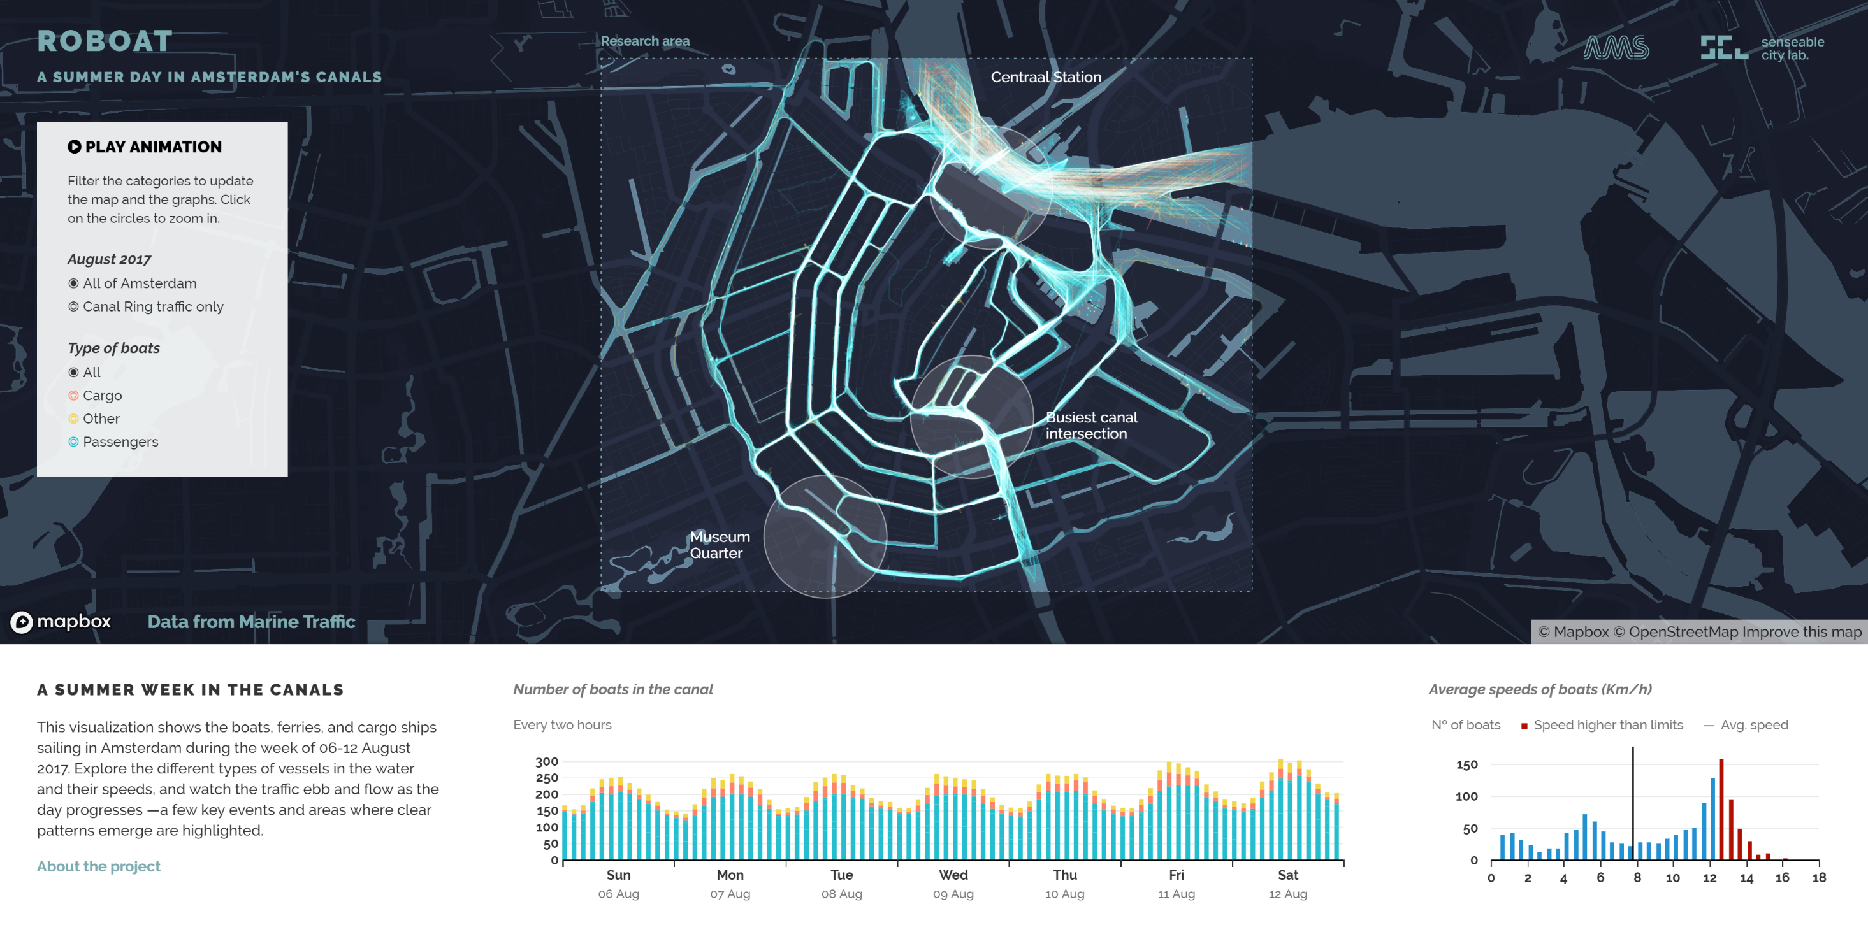

Slide 4
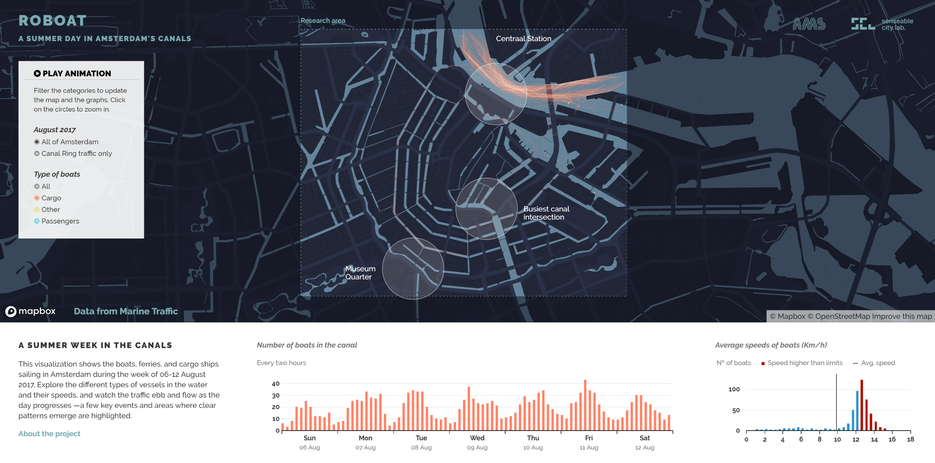

Slide 5


Slide 6
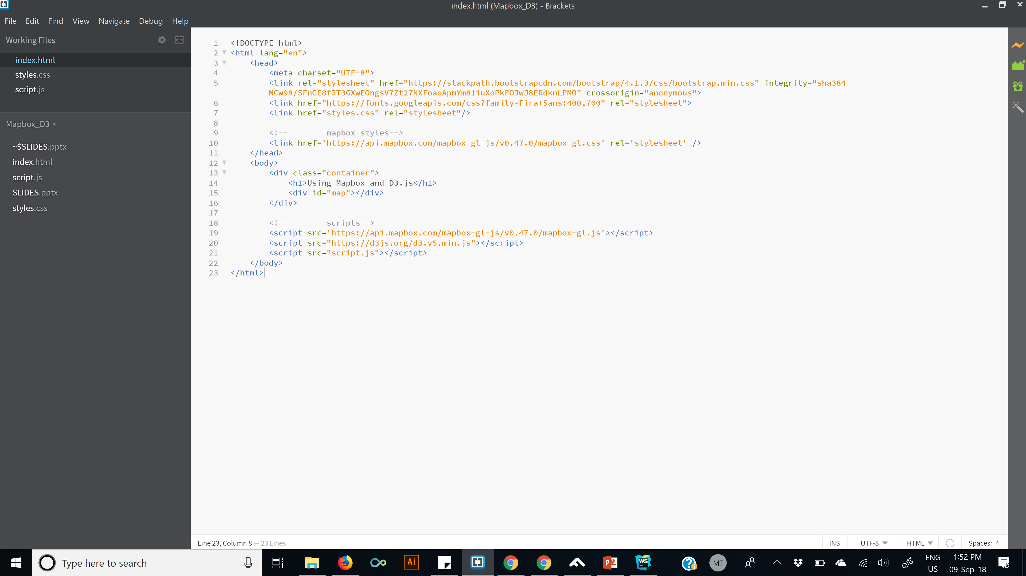
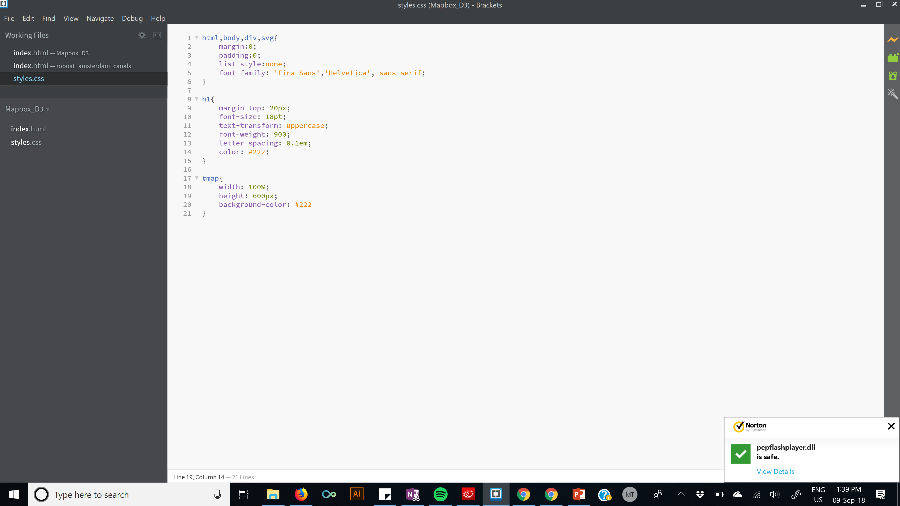
Starting point

Slide 7
Setting up the map
// mapbox access token mapboxgl.accessToken = ‘yourAccessToken' //setup map var mapboxMap = new mapboxgl.Map ({ container: 'map', // id of the div where the map is going to be center: [-0.141099, 51.515419], //lonlat of the center of our map zoom: 15, style: ‘mapboxURLStyle' })

Slide 8
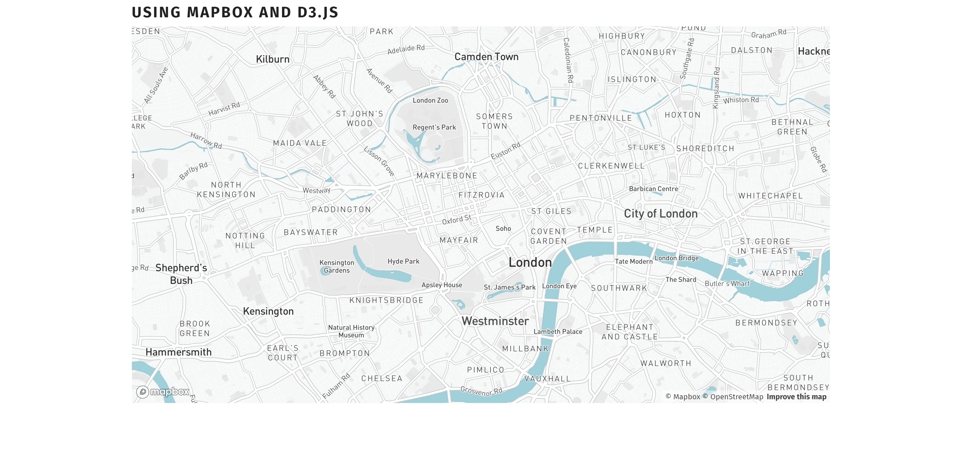

Slide 9
Projection function
// mapbox access token mapboxgl.accessToken = ‘yourAccessToken' //setup map var mapboxMap = new mapboxgl.Map ({ container: 'map', // id of the div where the map is going to be center: [-0.141099, 51.515419], //lonlat of the center of our map zoom: 15, style: ‘mapboxURLStyle' })
// projection function function projection (lonlat){ var p = mapboxMap.project(new mapboxgl.LngLat(lonlat[0],lonlat[1])); return [p.x, p.y] }

Slide 10
Translating…

Slide 11
Let’s draw!
// lets draw circles and paths var points = [ {x:-0.141905, y: 51.515487}, //oxford circus {x:-0.145231, y: 51.516949} ] var path = [points[0], {x:-0.142699, y: 51.517443}, points[1]]

Slide 12
Create an svg
// lets draw circles and paths var points = [ {x:-0.141905, y: 51.515487}, //oxford circus {x:-0.145231, y: 51.516949} ] var path = [points[0], {x:-0.142699, y: 51.517443}, points[1]]
// create svg var container = mapboxMap.getCanvasContainer(); var plot = d3.select(container).append("svg");

Slide 13
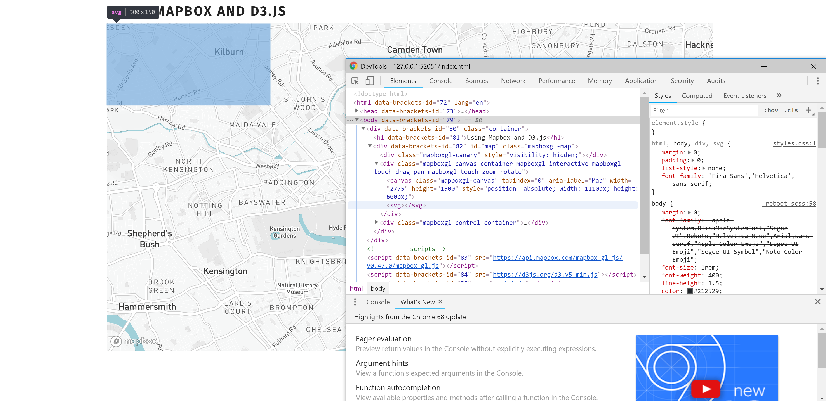

Slide 14
Add width and height attributes to the svg
html,body,div,svg{ margin:0; padding:0; list-style:none; font-family: 'Fira Sans','Helvetica', sans-serif; } h1{ margin-top: 20px; font-size: 18pt; text-transform: uppercase; font-weight: 900; letter-spacing: 0.1em; color: #222; } #map, #map svg, #map #animation { width: 100%; height: 600px; /* background-color: #222*/ }

Slide 15
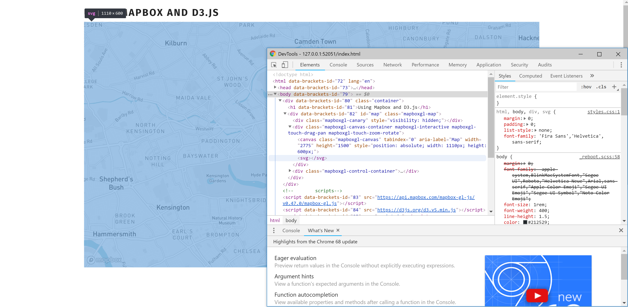

Slide 16
Let’s draw circles
// draw circles var circles = plot.selectAll(".points") .data(points); circles.enter() .append("circle") .attr("class","points") .attr("cx",function(d){return projection([d.x,d.y])[0]}) .attr("cy",function(d){return projection([d.x,d.y])[1]}) .attr("r",15) .style("fill", "#00afff");

Slide 17
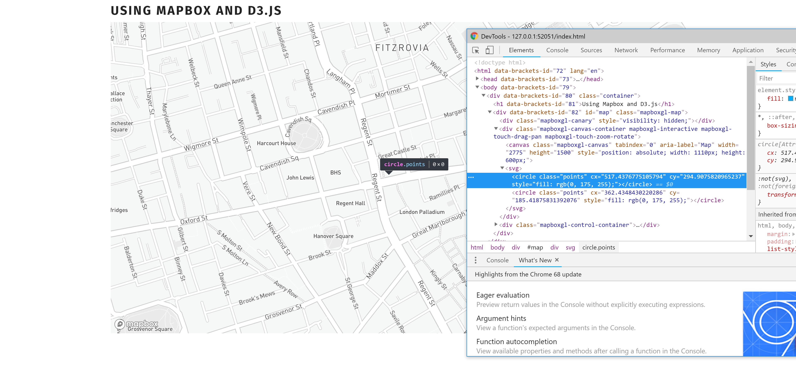

Slide 18
Add width and height attributes to the svg
html,body,div,svg{ margin:0; padding:0; list-style:none; font-family: 'Fira Sans','Helvetica', sans-serif; } h1{ margin-top: 20px; font-size: 18pt; text-transform: uppercase; font-weight: 900; letter-spacing: 0.1em; color: #222; } #map, #map svg, #map #animation { width: 100%; height: 600px; /* background-color: #222*/ } #map canvas { mix-blend-mode: multiply }

Slide 19
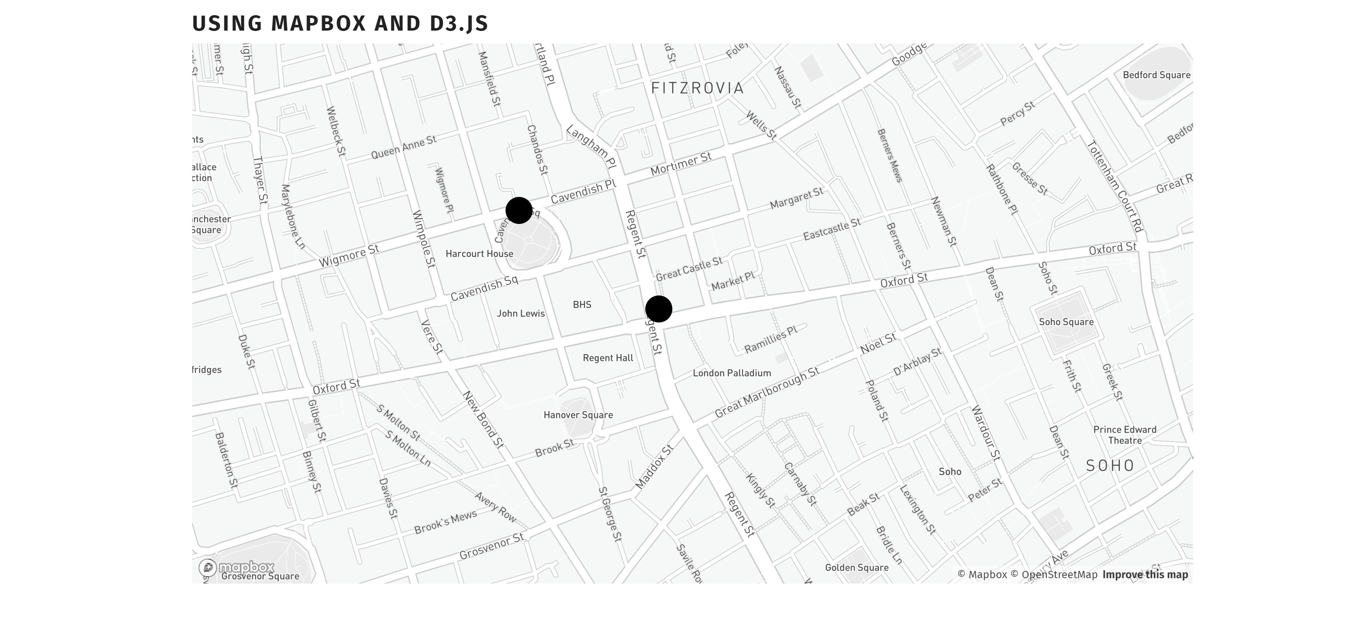

Slide 20
Draw a path
// draw lines var pathLine = d3.line() .x(function (d) { return projection([d.x,d.y])[0] }) .y(function (d) { return projection([d.x,d.y])[1] }); plot .append("path") .attr("d",pathLine(path)) .style("fill","none") .style("stroke-width",2) .style("stroke", "#00afff");

Slide 21
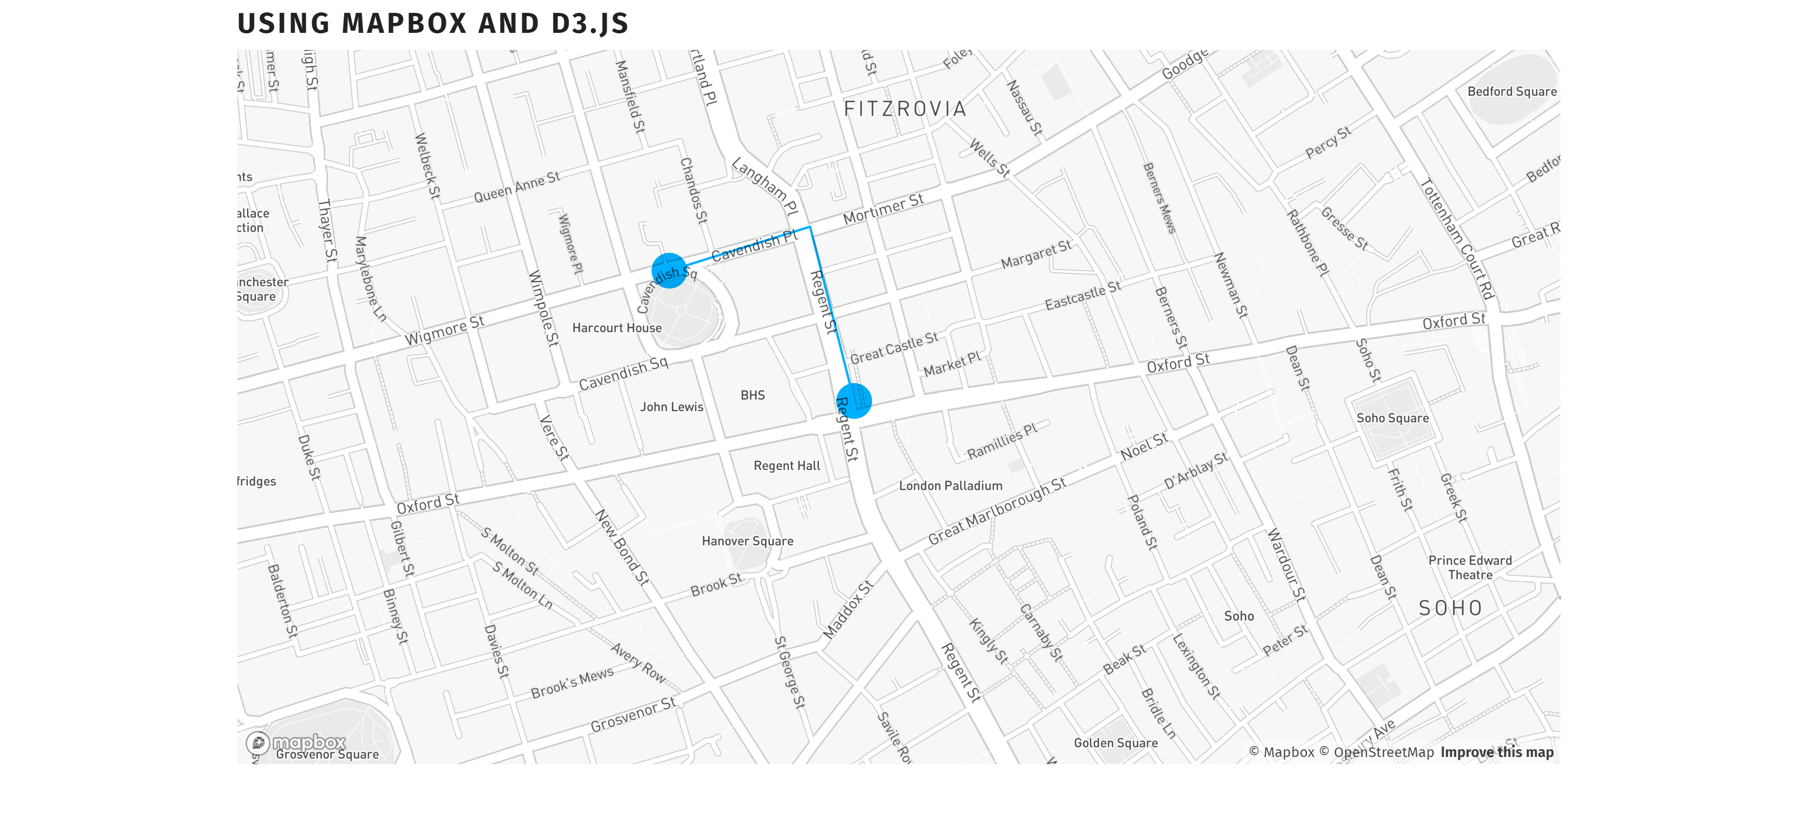

Slide 22
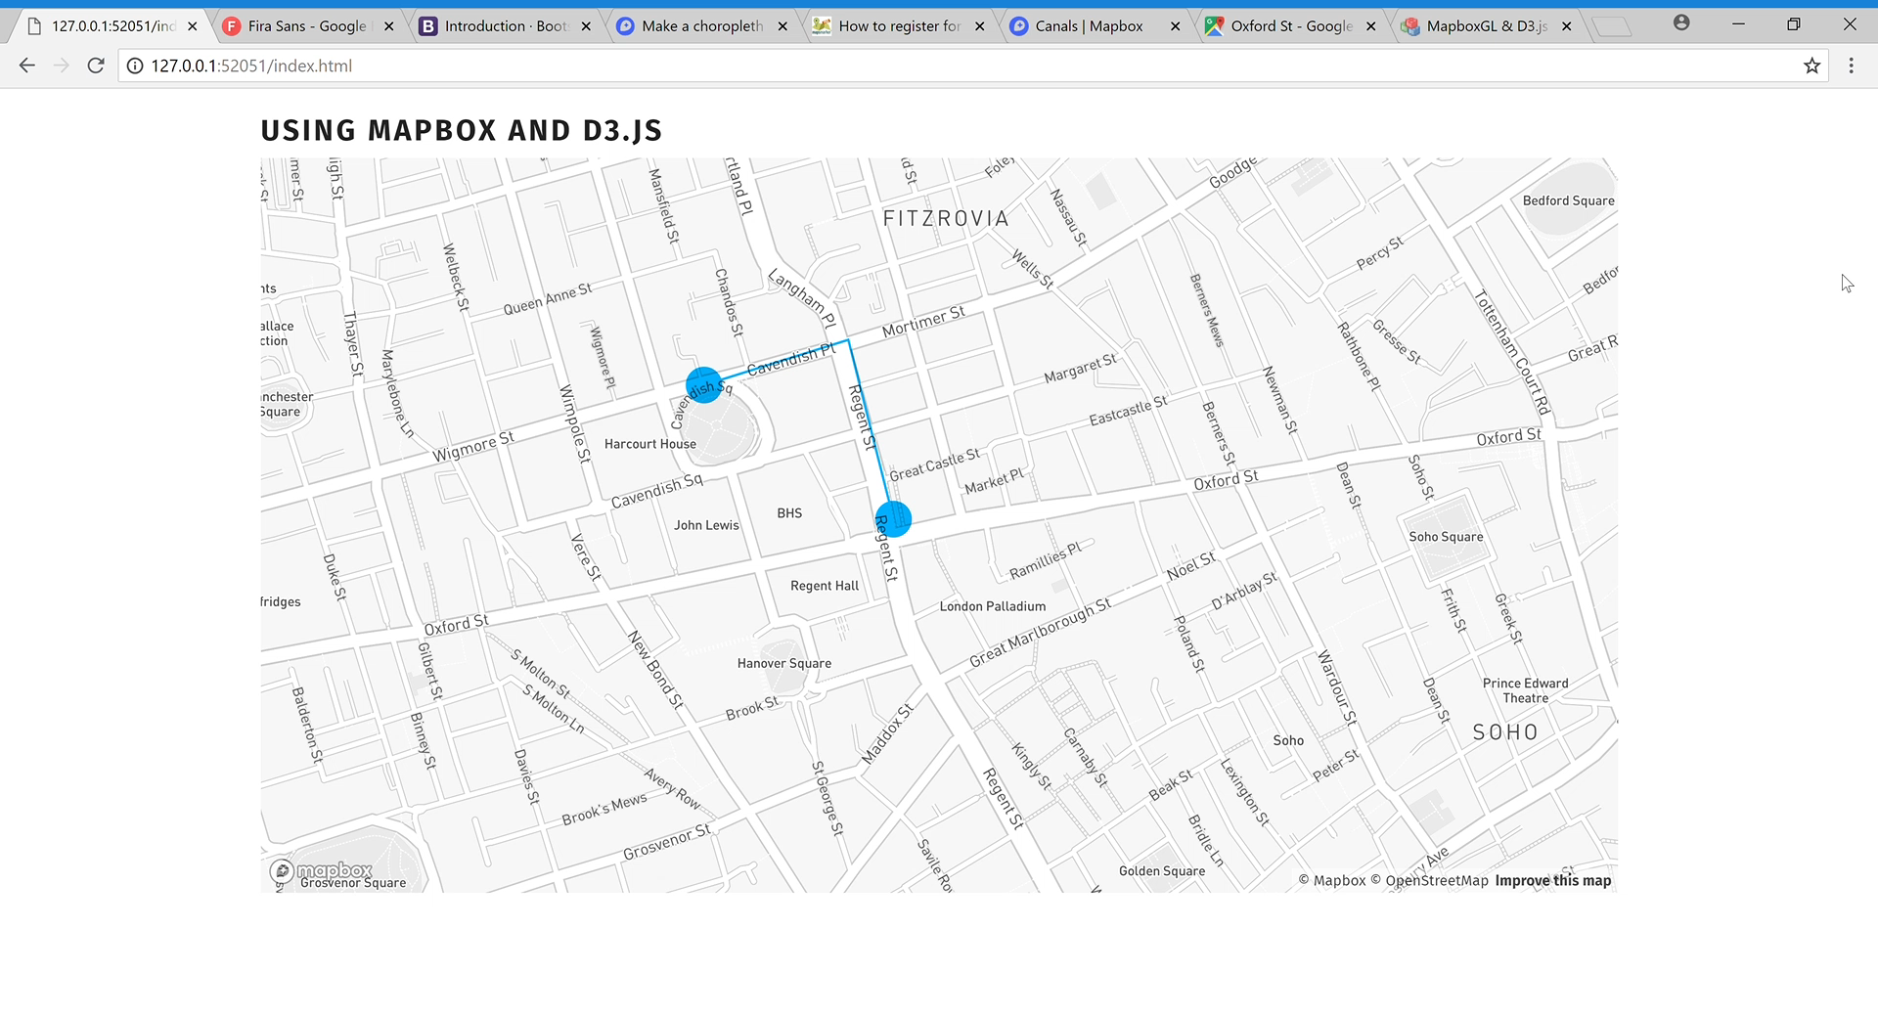

Slide 23
Updating elements when map moves
// update when map moves mapboxMap.on("viewreset", update); mapboxMap.on("moveend", update); function update(){ plot.selectAll(".points") .attr("cx",function(d){return projection([d.x,d.y])[0]}) .attr("cy",function(d){return projection([d.x,d.y])[1]}); plot.selectAll("path") .transition() .duration(1000) .attr("d",pathLine(path)) }

Slide 24
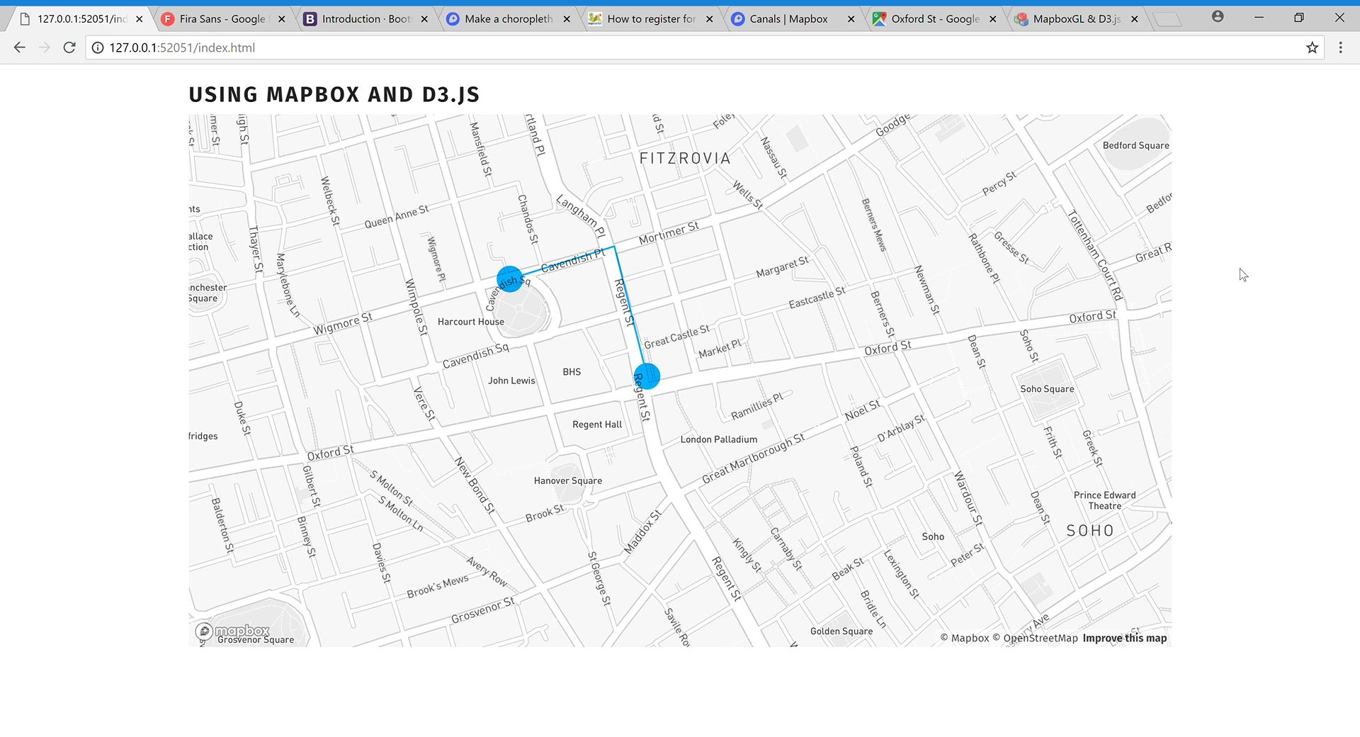

Slide 25
And the animation? Container with canvas
// create svg var container = mapboxMap.getCanvasContainer(); // get width and height of map div var width = d3.select('#map').node().clientWidth, height = d3.select('#map').node().clientHeight; // create canvas d3.select(container).append("div").attr("id", "animation"); var canvas = d3.select("#animation").append("canvas").attr("id", "dots-moving").node(); canvas.width = 2 * width; canvas.height = 2 * height; var ctxPLOT = canvas.getContext("2d");

Slide 26
And the animation? Animation settings: t and speed
// animation settings var t = 0; // starting time var speed = 0.5; // animation speed var color = '#00afff'; ctxPLOT.globalCompositeOperation = 'normal'; ctxPLOT.imageSmoothingEnabled = false; ctxPLOT.globalAlpha = 1; ctxPLOT.scale(2,2); var pathLine = d3.line() .x(function (d) { return projection([d.x,d.y])[0] }) .y(function (d) { return projection([d.x,d.y])[1] }) .context(ctxPLOT); function draw (){}

Slide 27
And the animation? Request animation frame
var requestAnimationFrame = window.requestAnimationFrame || window.mozRequestAnimationFrame || window.webkitRequestAnimationFrame || window.msRequestAnimationFrame; window.cancelRequestAnimFrame = (function () { return window.cancelAnimationFrame || window.webkitCancelRequestAnimationFrame || window.mozCancelRequestAnimationFrame || window.oCancelRequestAnimationFrame || window.msCancelRequestAnimationFrame || clearTimeout })();

Slide 28
And the animation? The animation
window.requestAnimationFrame(draw); function draw (){ ctxPLOT.clearRect(0, 0, width, height); // select point in time var drawPoint = animation.filter(function(d){return d.t >= t && d.t<= t+speed}); var drawLine = animation.filter(function(d){return d.t < t}); // line of past points ctxPLOT.globalAlpha = 1; ctxPLOT.beginPath(); pathLine(drawLine); ctxPLOT.lineWidth = 2; ctxPLOT.strokeStyle = color; ctxPLOT.stroke(); ctxPLOT.globalAlpha = 1; // last position var xy = projection([drawPoint[0].x,drawPoint[0].y]); ctxPLOT.fillStyle = color; ctxPLOT.beginPath(); ctxPLOT.arc(xy[0], xy[1], 5, 0,2*Math.PI); ctxPLOT.fill(); ctxPLOT.closePath(); points.forEach(function(d){ var xyCircle = projection([d.x,d.y]); ctxPLOT.fillStyle = "rgba(255,255,255,0)"; ctxPLOT.strokeStyle = "black"; ctxPLOT.lineWidth = 3; ctxPLOT.beginPath(); ctxPLOT.arc(xyCircle[0], xyCircle[1], 15, 0,2*Math.PI); ctxPLOT.stroke(); ctxPLOT.closePath(); }) if (t<20){ t = t + speed; }else{ t = 0 } window.requestAnimationFrame(draw); }

Slide 29
